Slide 1

Cell Processor Programming:
An introduction
Pascal Comte
Brock University, Fall 2007

Slide 2


Goals of Presentation
Latest Technology
Promote parallel programming
  Vector vs Scalar programming
Incite you to program & design in parallel
Meant to be informative
Technical details & inner works
Not to critique the design of the Cell Processor

Slide 3

Presentation Layout
IBM Cell Processor Design
IBM Cell Processor on Playstation 3
IBM Cell Processor SDK
From Scalar to Vector Programming
Levels of Parallelism
SPE Program Modules
Data Transfers & Communication
Programming Techniques
Program Example

Slide 4

Cell Processor Design

Slide 5
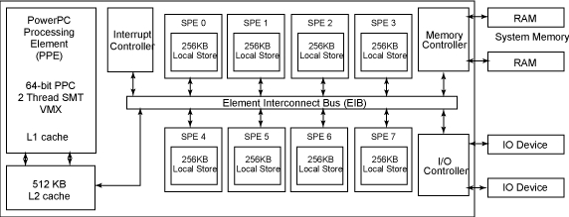


Cell Processor Architecture
PPE register file: 32 x 128-byte vectors
SPE register file: 128 x 128-byte vectors
PPE: dual-issue in-order processor
  In-order & out-of-order computation (load instructs.)‏
SPE: dual-issue in-order processor
  In-order computation & out-of-order data transfers

Slide 6
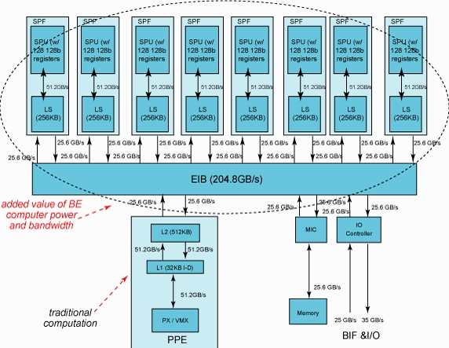
Cell Processor Architecture

Slide 7
Cell Processor Architecture
PPE design goals
  Maximize performance/power
  Maximize performance/area ratio
PPE main tasks
  Run OS (Linux)‏
  Coordinate with SPE's
SPE dedicated DMA engines
PPE & SPE's @ 3.2Ghz
External RAMBUS XDR Memory
  Two channels @ 3.2Ghz (400Mhz, Octal data rate)‏
IO Controller @ 5Ghz
SPE's parallel nature
  Even pipeline
  Odd pipeline

Slide 8
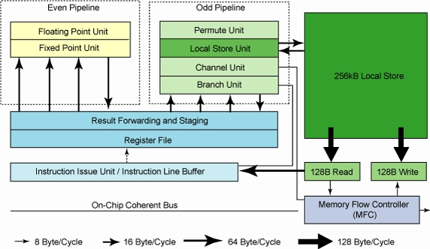
Cell Processor Design

Slide 9
Cell Processor on Playstation 3

Slide 10


Cell Processor on Playstation 3
Only 6 / 8 SPE's accessible
Only 256MB XDR memory
GigaBit Ethernet Controller
  High latency ~250us - why?
Wi-Fi Controller
4 USB ports
20GB – 40GB – 60GB and 80GB hard drives
Hypervisor - Virtualization Layer
Maximum power consumption / usual consumption

Slide 11
Cell Processor on Playstation 3
Linux Distributions available
  Fedora Core 5,6,7
  Yellow Dog 5.0+
  Gentoo PowerPC 64
  Debian
  IBM'S choice: Fedora
Easy installation
  Format PS3 Hard drive
  USB key required for otherOS
  Cell Addon CD
  Fedora PPC DVD
Linux Kernel 2.6.20+ full support for PS3
Gcc compiler for C/C++/Fortan 95 for PPE
Access to SPE requires IBM Cell SDK

Slide 12
IBM Cell Processor SDK

Slide 13

Cell Processor SDK
SDK 2.1
  Fedora Core 6
  GNU tool chain by Sony Computer Entertainment
  IBM XL C/C++ Compiler
  IBM Full System Simulator
  Sysroot Image for System Simulator
  SIMD math library
  MASS (Mathematical Acceleration SubSystem)‏
  Samples code
  IBM Eclipse IDE for Cell BE
SDK 3.0
  Fedora Core 7
  BLAS library (single & double precision linear algebra functions)‏
  GNU Ada compiler for PPE

Slide 14
Cell Processor SDK
  GNU Fortan compiler for PPE & SPE
  Numactl library (for non-uniform memory access machines)‏
  FFT Library – 1D & 2D Fast Fourier Transforms
  Random Number Generation (good for simulations)‏
  SPU Isolation runtime environment – signing & encrypting SPE apps.

Slide 15
From Scalar to Vector Programming

Slide 16
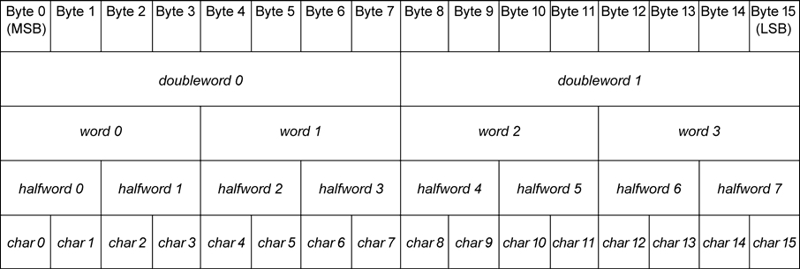
From Scalar to Vector Programming
Cell designed for vector computations
  Vector arithmetic faster than scalar arithmetic
Designed for fast SIMD processing
Vector Big endian order

Slide 17
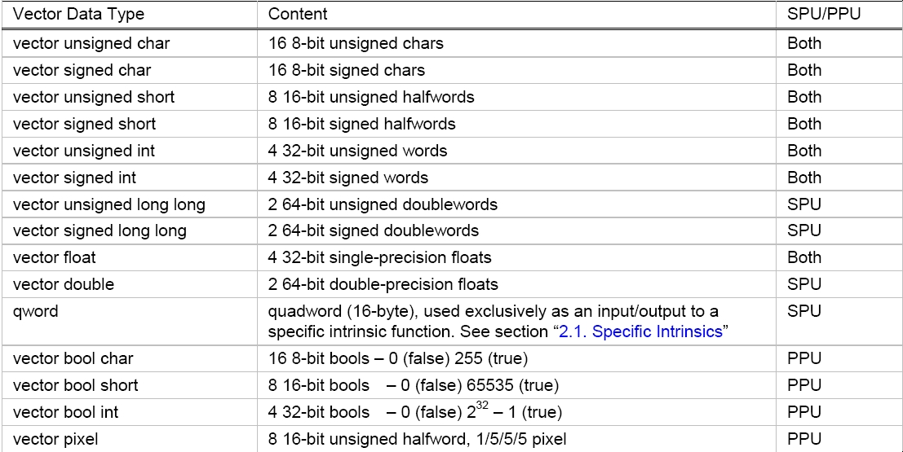
From Scalar VS Vector Programming

Slide 18
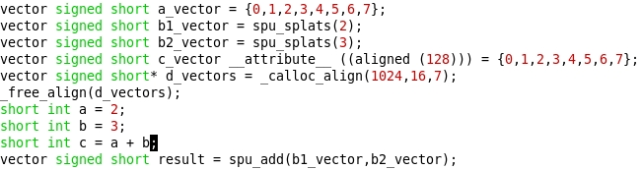
From Scalar to Vector Programming
Sizeof() on a vector always returns 16
Default vector alignment to 16-byte boundary
'result' addition faster than 'c' addition

Slide 19
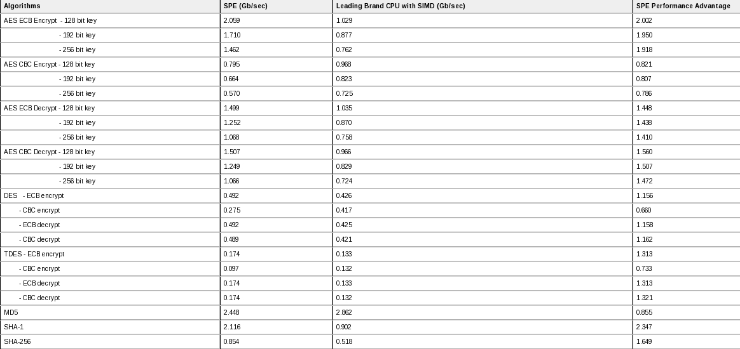
From Scalar to Vector Programming
Cryptography performance up to 2.3x at the same frequency than a leading brand processor with SIMD

Slide 20
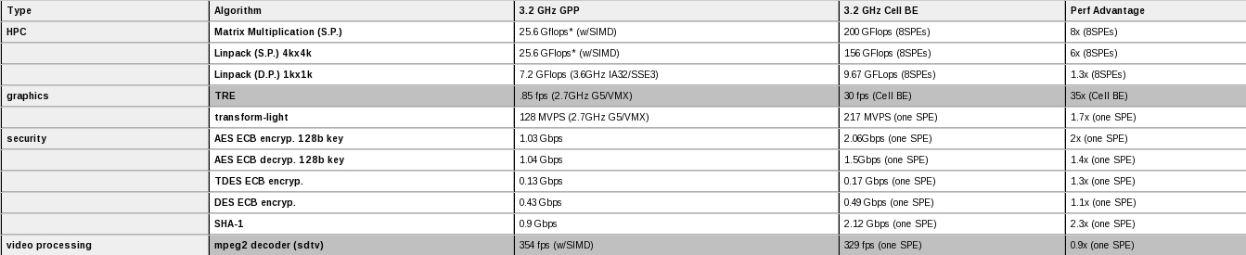
From Scalar to Vector Programming
High bandwidth
Best area efficiency processor on the market*

Slide 21
Levels of Parallelism

Slide 22

Levels of Parallelism
Breaking a problem into modules
  Same or different modules
  Modularity of SPE's
SIMD operations on vector data types
  Arithmetic intrinsics
    spu_add – vector add
    spu_madd – vector multiply and add
    spu_msub – vector multiply and subtract
    spu_mul – vector multiply
    spu_sub – vector subtract
    spu_nmadd – negative vector multiply and add
    spu_nmsub – negative vector multiply and subtract
    spu_re – vector float reciprocal estimate
    spu_rsqrte – vector float reciprocal square-root estimate
  Byte Operation intrinsics
    spu_absd – vector absolute difference
    spu_avg – average of 2 vectors

Slide 23
Levels of Parallelism
  Compare intrinsics
    spu_cmpabseq – element-wise absolute equal
    spu_cmpabsgt – element-wise absolute greater than
    spu_cmpeq – element-wise equal
    spu_cmpgt – element-wise greater than
  Bits and Mask intrinsics
    spu_sel – select bits
    spu_shuffle – shuffle 2 vectors of bytes
  Logical intrinsics
    spu_and – vector bit-wise AND
    spu_nand – vector bit-wise complement AND
    spu_nor – vector bit-wise complement OR
    spu_or – vector bit-wise OR
    spu_xor – vector bit-wise XOR

Slide 24
Levels of Parallelism
SIMD Math Library
  Too many to list
SPE:
  Even pipeline:
    Float, double and integer multiplies unit
    Fixed-point arithmetic, logical ops., word shifts unit
  Odd pipeline:
    Fixed-point permutes, shuffles, quadword rotates unit
    Instruction sequencing, branching execution control unit
    Local store load/save/supply instructions to control unit
    DMA channel for input/output through MFC
Channel interface independent of SPE
SPE issue & complete 2 instructions / cycle

Slide 25
SPE Program Modules

Slide 26
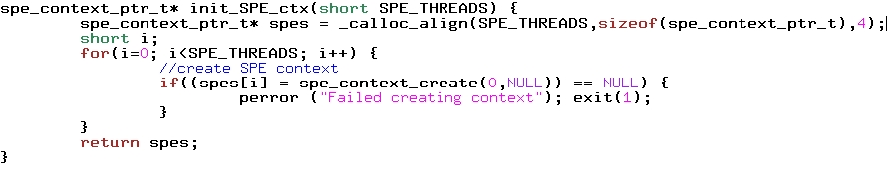
SPE Program Modules
Separate compiler for SPE
  Embed SPE executable into library
  'extern spe_program_handle_t <program_name>'
  Compile main PPU program with library
SPE Context
  How to appropriate yourself SPEs for computation...

Slide 27
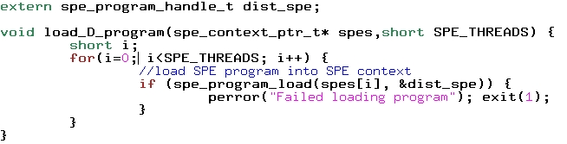
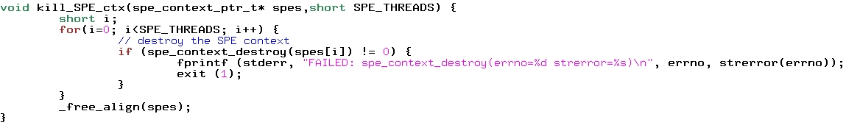
SPE Program Modules
  How to load a SPE program into SPEs...
  How to release SPEs...

Slide 28
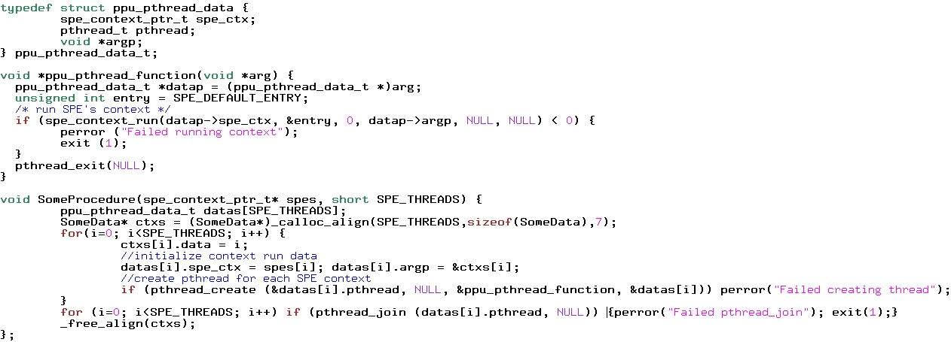
SPE Program Modules
  How run pthreads with the SPEs example...

Slide 29
Data Transfers & Communication

Slide 30
Data Transfers & Communication
Data transfers initiated with spu_mfcdma32() or spu_mfcdma64()‏
Tell the SPE's MFC which channel (0) to use
  spu_writech(MFC_WrTagMask,-1);
Wait for data to be completely transfered
  spu_mfcstat(MFC_TAG_UPDATE_ALL);
Different modes of data transfers:
  MFC_PUT_CMD
  MFC_PUTB_CMD
  MFC_PUTF_CMD
  MFC_GET_CMD
  MFC_GETB_CMD
  MFC_GETF_CMD

Slide 31
Data Transfers & Communication
MFC_PUTF_CMD & MFC_PUTB_CMD:
  'F' for Fence:
    command is locally ordered w.r.t. all previously issued commands within the same tag group and command queue
  'B' for Barrier:
    command and all subsequent commands with the same tag ID as this command are locally ordered w.r.t. all previously issued commands within the same tag group and command queue
PPU & SPE MailBox
SPE Events

Slide 32
Programming Techniques

Slide 33
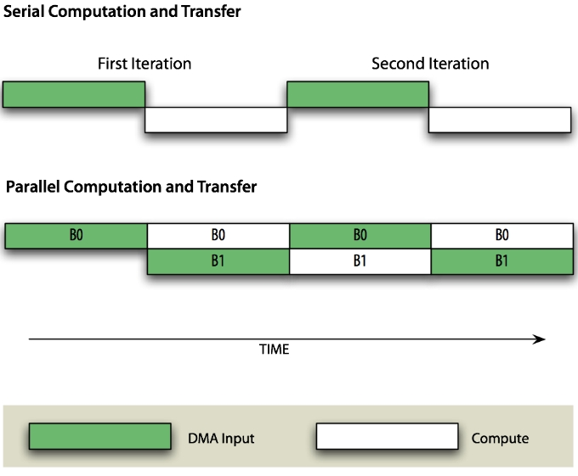
Programming Techniques
XLC C/C++ Compiler vs GCC
  Which to choose?
  __align_hint(); (SPE only)‏
    Improves data access through pointers
    Provides information to compiler for auto-vectorization
  __builtin_expect();
    Programmer directed branch-prediction
Double Buffering

Slide 34
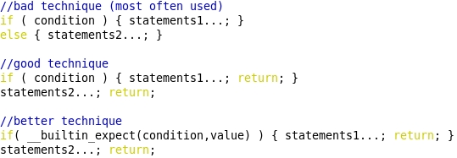
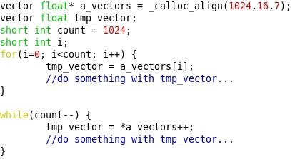
Programming Techniques
Program flow: limit branching if statements...
Pointer arithmetic

Slide 35
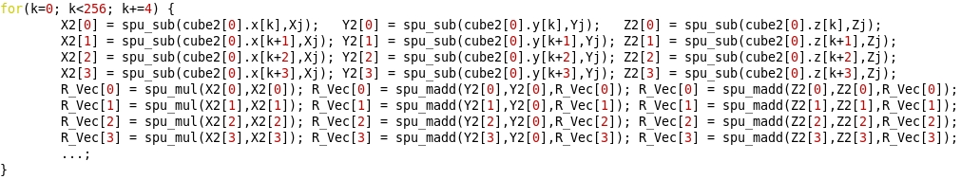
Programming Techniques
Loop unrolling... especially inner-most loops
Code's width

Slide 36
Program Example

Slide 37
Simple Hello World!

